Slide 1


CS 513 - KNOWLEDGE DISCOVERY & DATA MINING
Airline Passenger Satisfaction

Slide 2




Team Members
HARSH AGRAWAL
CWID- 10475285
CS-513B
AMIT RAMJEE
CWID-10457040
CS-513B
ABHISHEK AMBERKAR
CWID- 10469370
CS-513B
SHWETA MISHRA
CWID-10476307
CS-513A

Slide 3
TODAY’S AGENDA
Discussion of Dataset
Problem Statement / Objective
Overview of Classification Techniques
EDA & Correlation Heatmap
Detailed Classification/Clustering Analysis
Conclusions

Slide 4
AIRPLANE PASSENGER SATISFACTION DATASET
Dataset Variables Attributes
Row
id
Gender
Customer Type
Age
Type of Travel
Class
Flight Distance
Inflight wifi service
Departure/Arrival time convenient
Ease of Online booking
Gate location
Food and drink Online boarding
Seat comfort
Inflight entertainment
On-board service
Leg room service
Baggage handling
Checkin service
Inflight service
Cleanliness
Departure Delay in Minutes
Arrival Delay in Minutes
Satisfaction
Business
Eco Plus
Link: Airline Passenger Satisfaction | Kaggle
Training data: 25 columns and 103,905 training rows of data.
Test data: 25 columns and 25,977 rows
Categorical & Numeric columns
Binary outcome variable: Satisfaction as ‘satisfied’ or ‘neutral of dissatisfied’
Passenger numerical ratings (1 – 5)
Cleaned data : replaced any blanks with median for Arrival Delay in Minutes

Slide 5
PROBLEM STATEMENT & OBJECTIVE
Problem Statement
Airline passengers often times experience a less than satisfying travel experience despite efforts avoid a bad experience (seat selection, travel class type, Wi-Fi, food options).
There is an opportunity for airlines operating in the industry to improve their overall service across the board to help optimize passenger satisfaction, therefore it is key for airlines to understand which factors play a role in this.
Objective
Predict the satisfaction of an airline passengers based on their respective different taggings and customer feedback.
To understand the categories (feedback and taggings) which have a larger influence/impact upon passenger satisfaction across the board.

Slide 6
CLASSIFICATION TECHNIQUES USED
Techniques
Naive Bayes
KNN
CART Decision Tree
C5.0 Algorithm
Random Forest
SVM

Slide 7

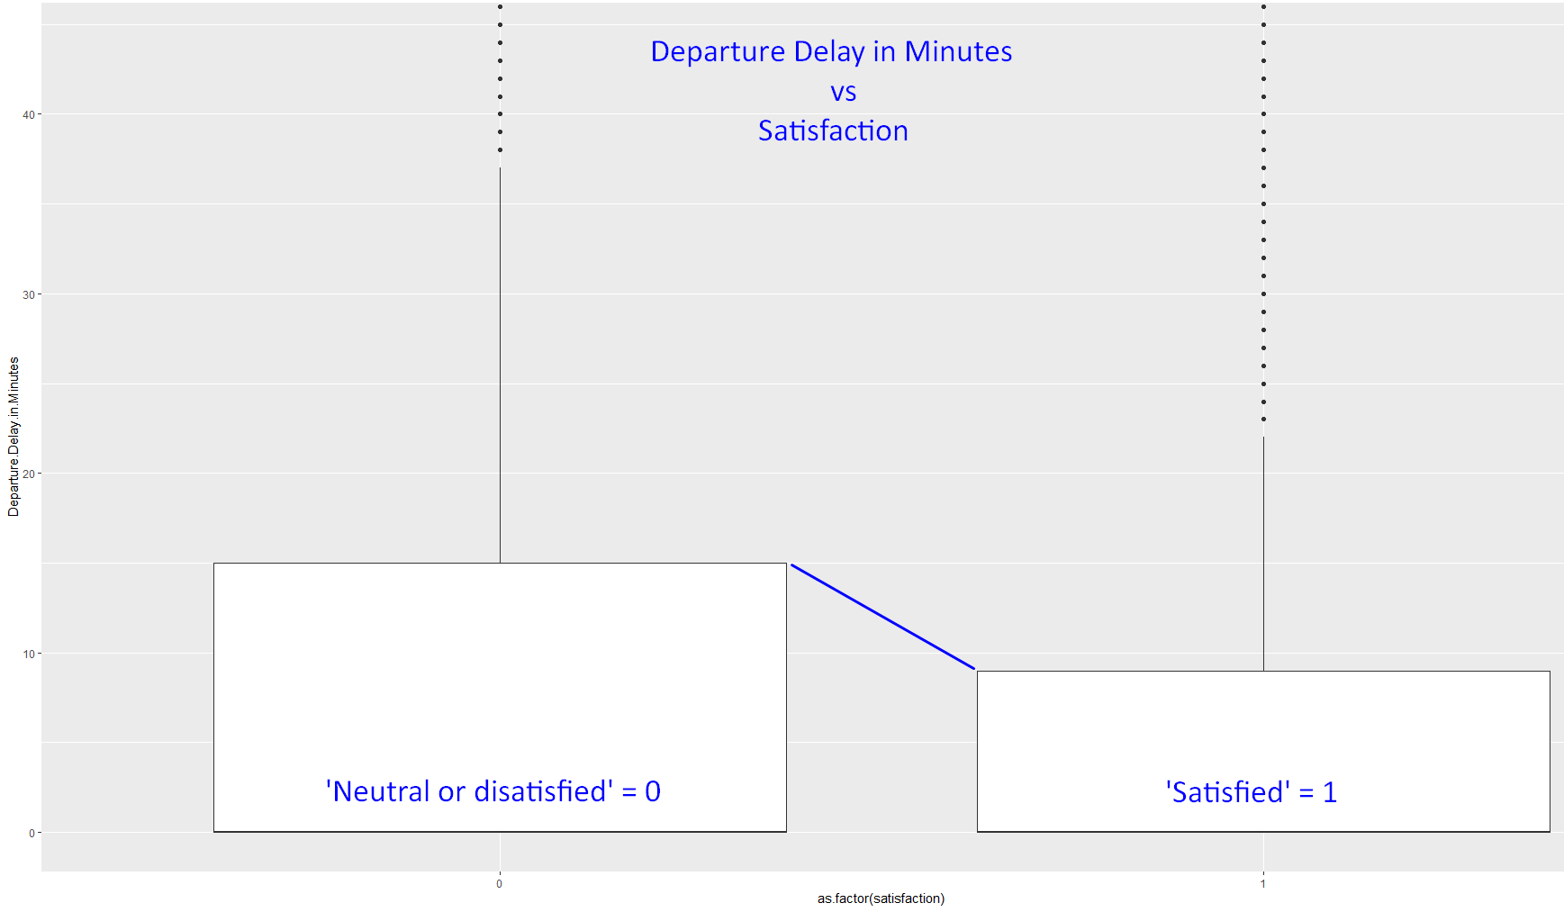
EDA: DOES DEPARTURE DELAY IMPACT SATISFACTION?
Shouldn’t departure delay have an impact on passenger satisfaction?
Boxplot shows airplane departure delayal does not impact passenger satisfaction. There is little difference in delayal minutes between those satisfied vs. not (~5-7 minutes)

Slide 8

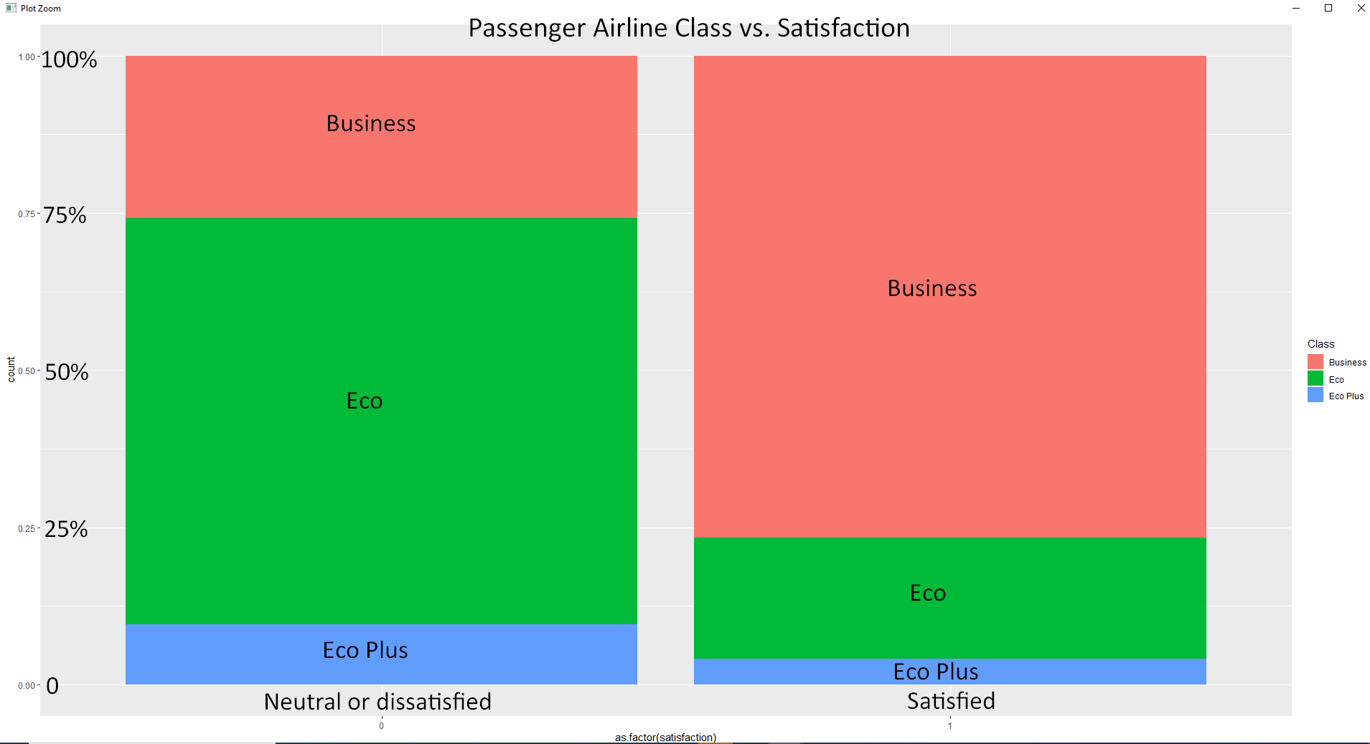
EDA: HOW DOES AIRLINE CLASS INFLUENCE SATISFACTION?
As expected, satisfied passengers were more likely to fall in the business class (approx.75%) vs. ‘neutral or dissatisfied’ who mostly flew Economy class (~60%).

Slide 9
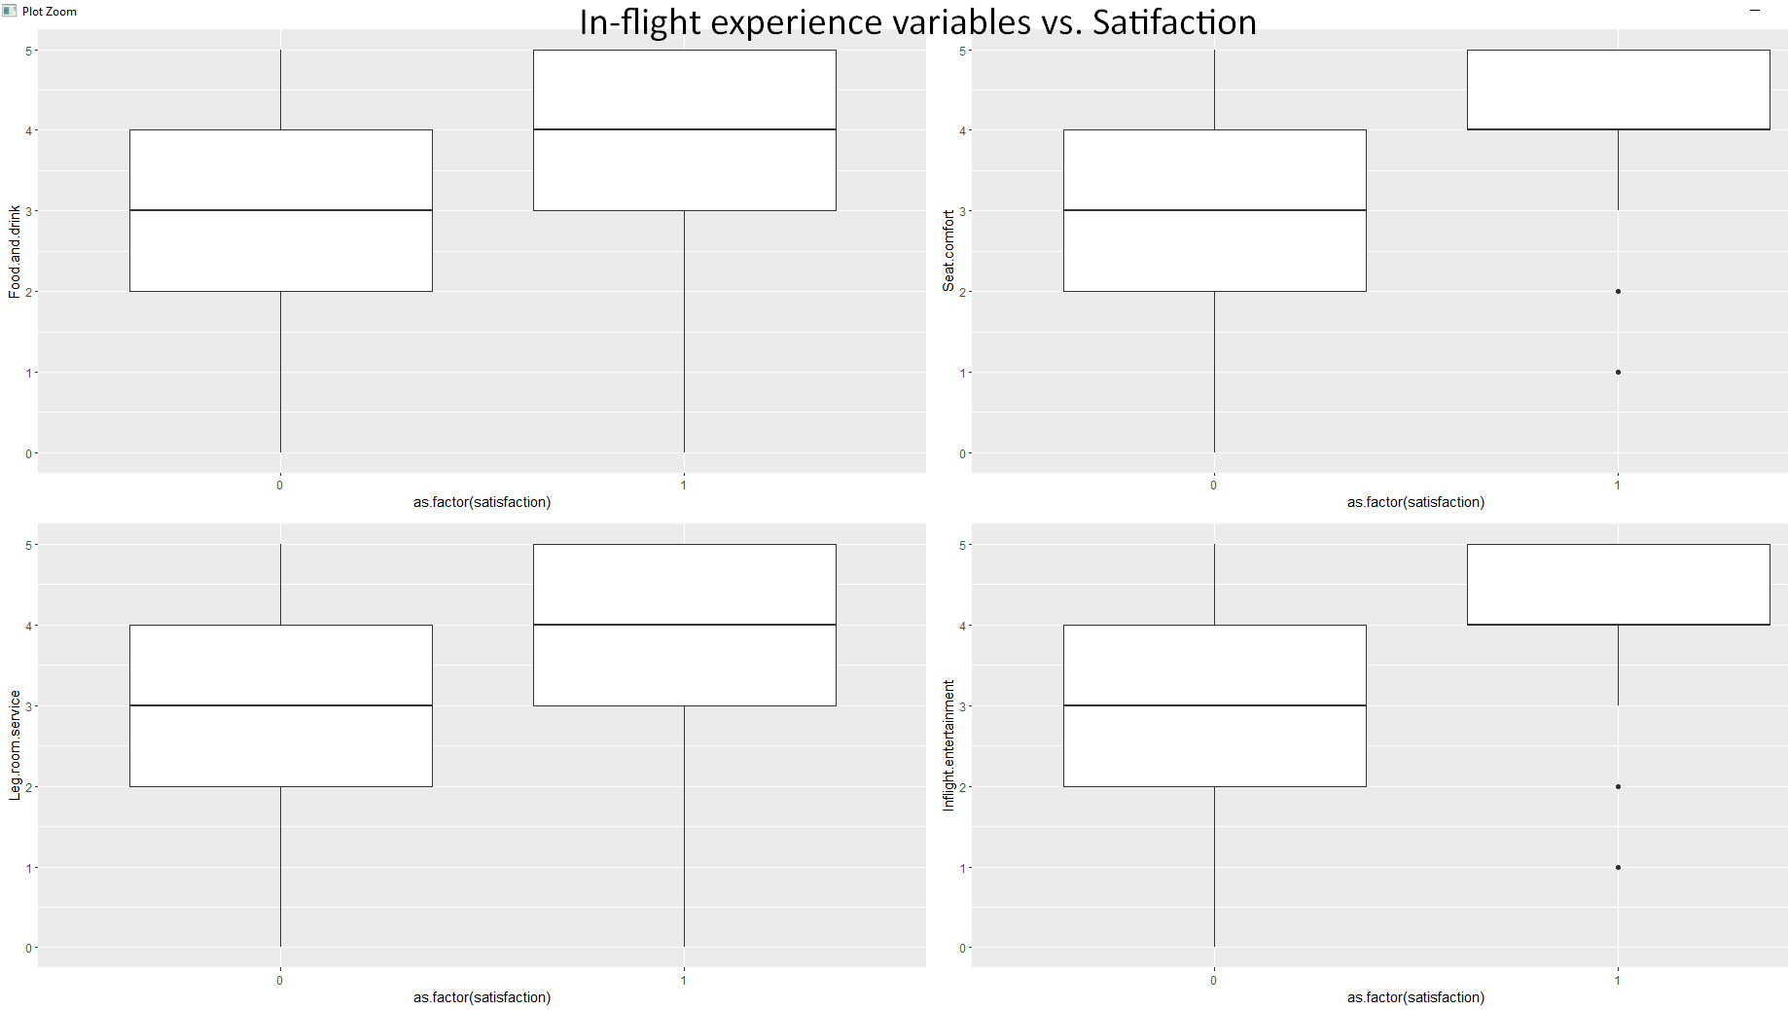

EDA: HOW DOES AIRLINE CLASS INFLUENCE SATISFACTION?
Satisfied passengers gave one rating better than those who were ‘neutral or dissatisfied’.

Slide 10
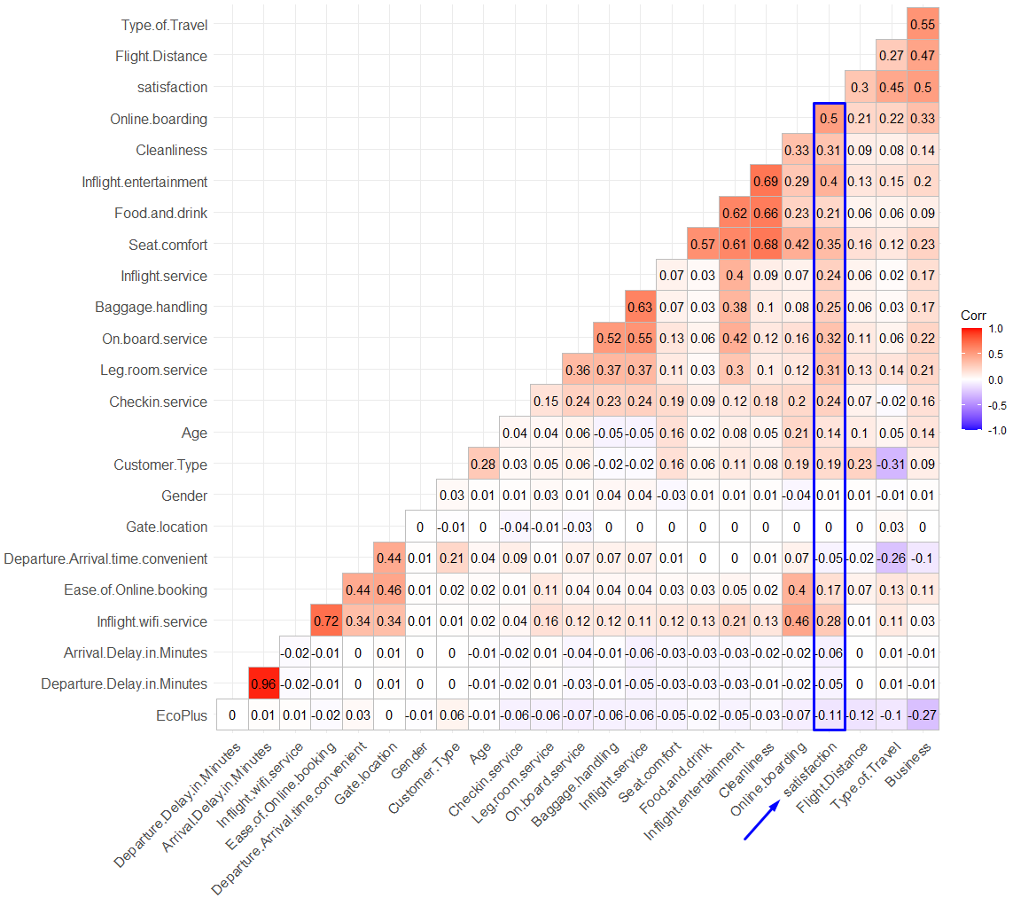

CORRELATION HEATMAP
Changed categorical variables into numeric, split the Airline class into Business vs. Eco Plus
Selected attributes with higher correlation to satisfaction, which was mostly in-flight passenger experience

Slide 11
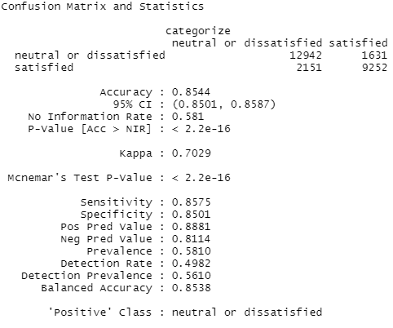
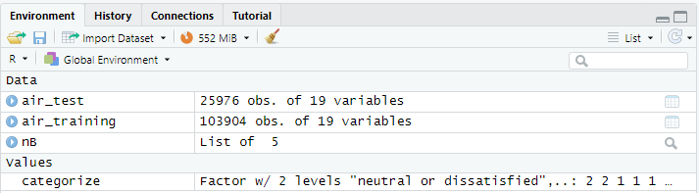
NAÏVE BAYES
Accuracy: ~85.4%

Slide 12
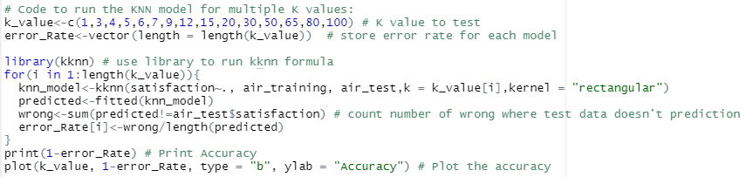
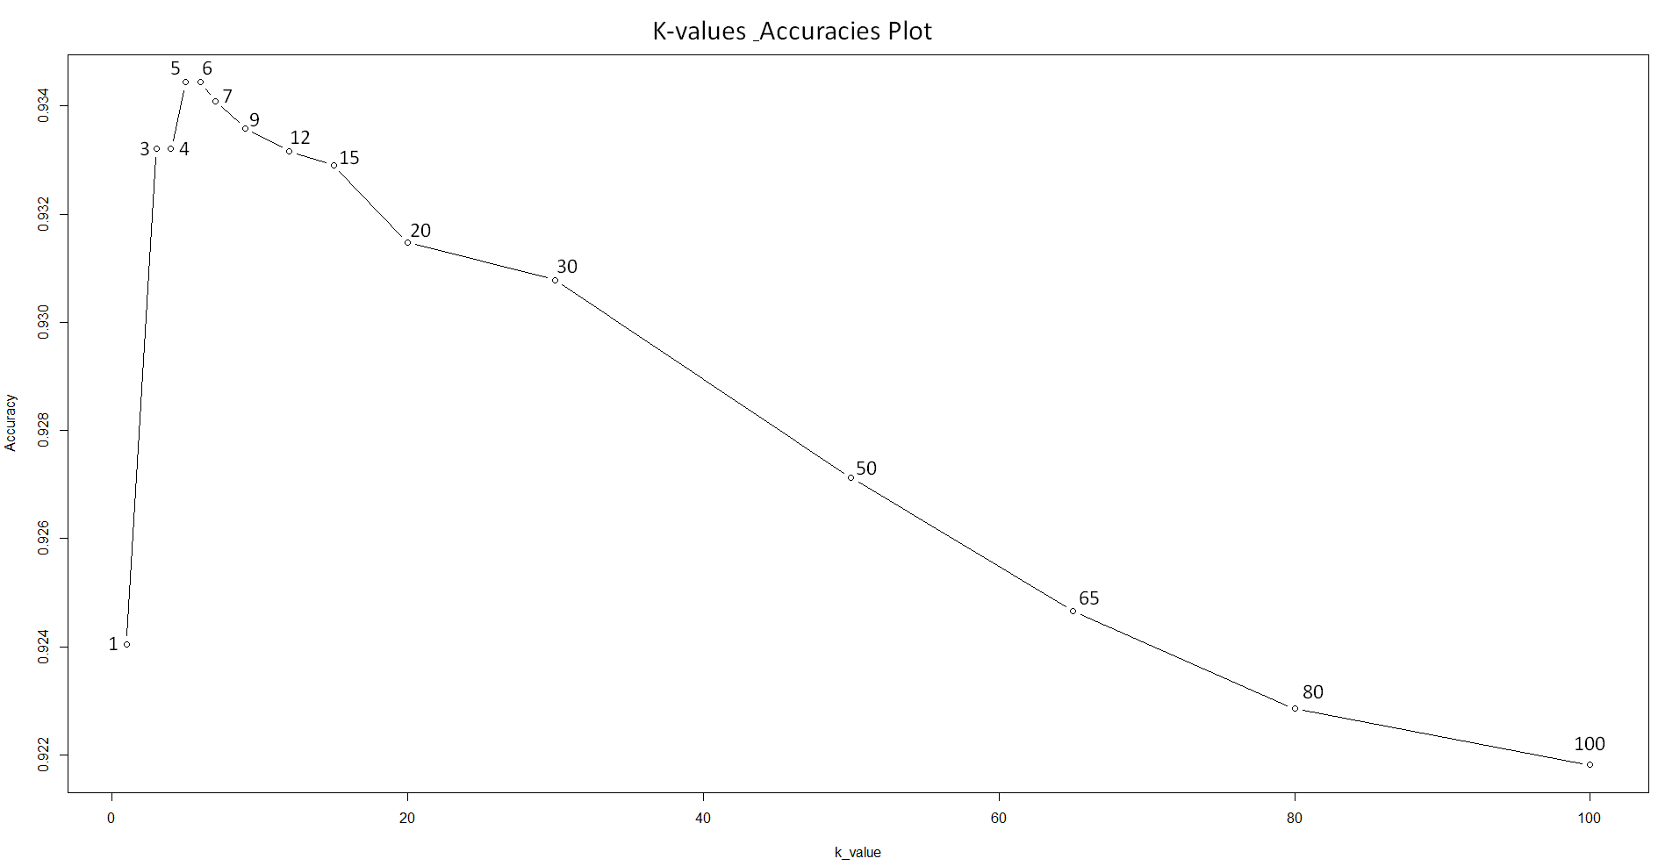
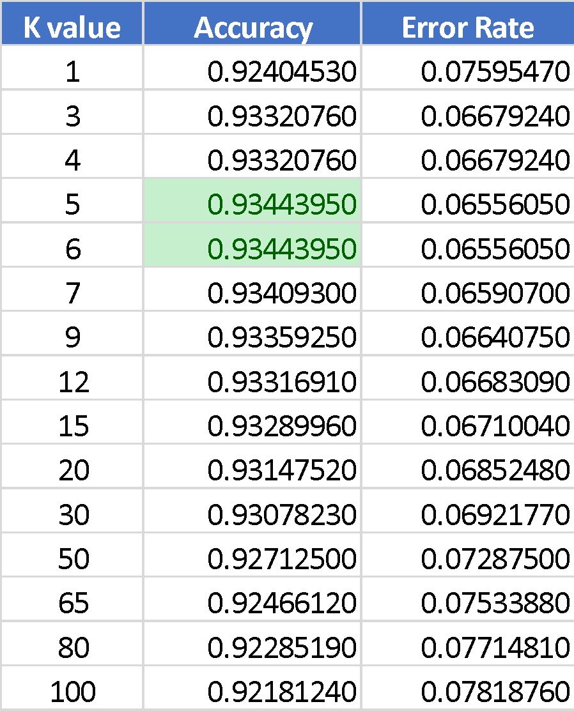
KNN METHOD
Accuracy: ~93.4%

Slide 13
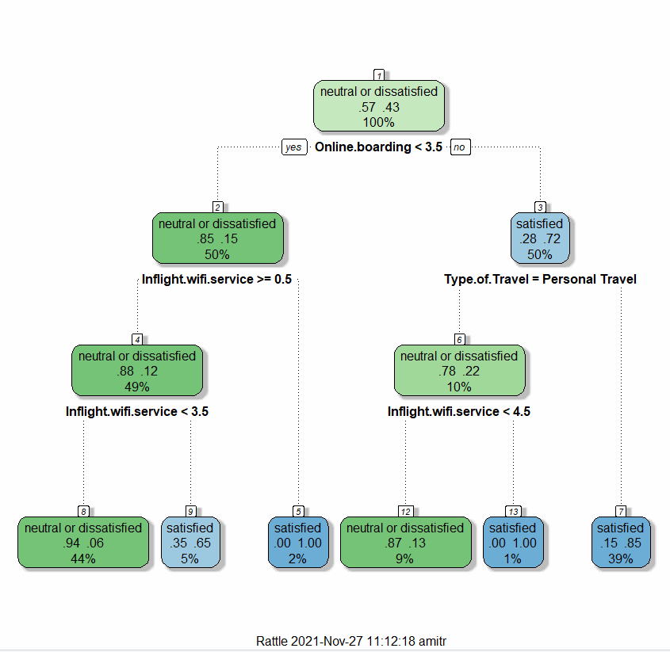

CART DECISION TREE
Accuracy: ~88.3%

Slide 14
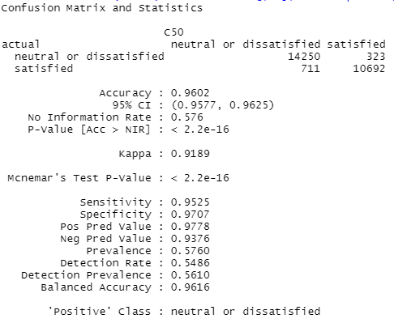
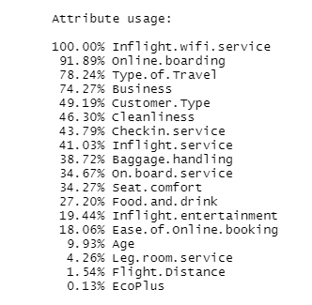
C5.0 ALGORITHM
Accuracy: ~96.0%,
Training Data Summary

Slide 15
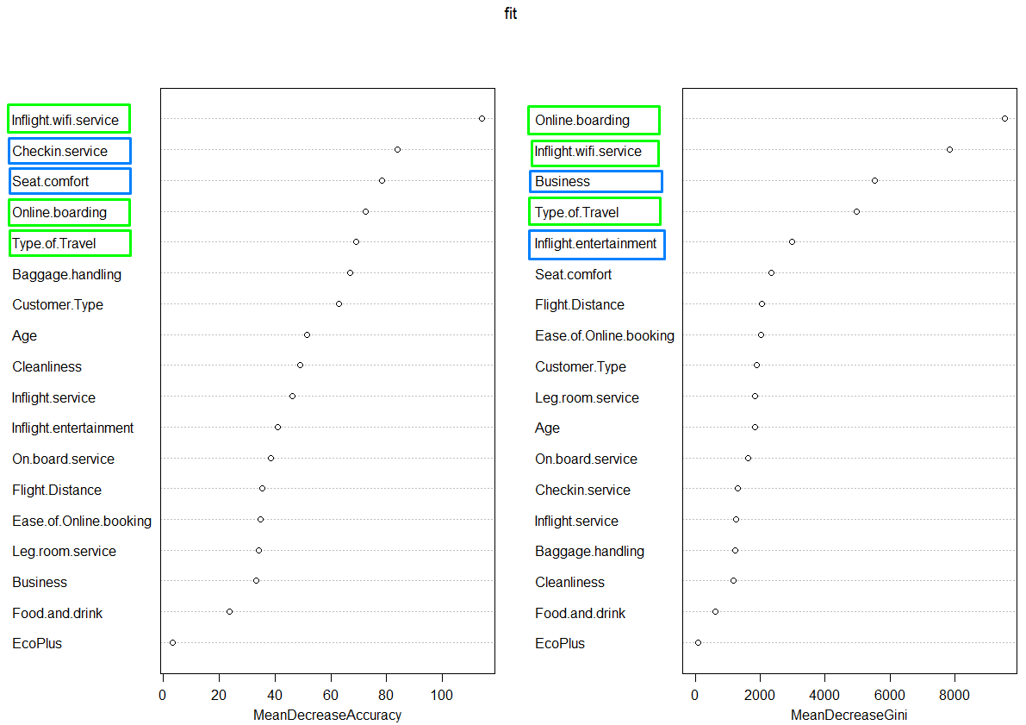
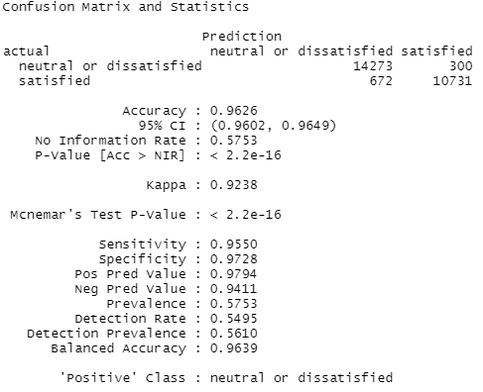
RANDOM FOREST
Fit Plot
Accuracy: ~96.2%

Slide 16
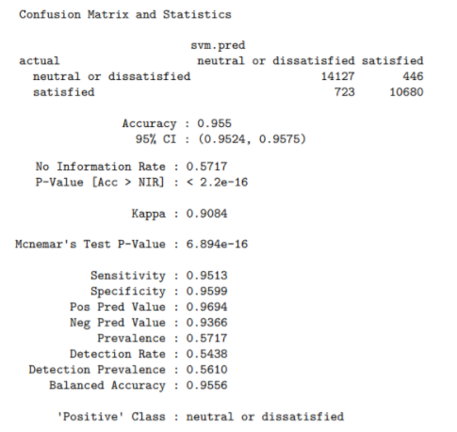
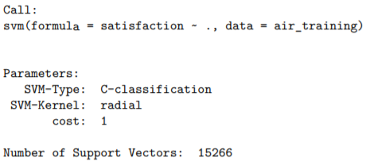
SVM
Model Summary
Accuracy: ~95.5%

Slide 17
CONCLUSIONS
We have derived the following conclusions
Customer satisfaction is most closely linked to their on-flight experience.
If the outliers are ignored, there is little difference in satisfaction for a flight delay departure of 5 to 7 minutes.
In comparison to neutral or unsatisfied consumers, satisfied customers provided a higher rating for in-flight user experience factors (seat comfort, food/drink, leg room, entertainment)
The Random Forest method yielded the highest accuracy for the user's contentment based on their experiences followed closely by the C5.0 and SVM.
Method | Accuracy
NAÏVE BAYES | 85.4%
KNN | 93.4%
CART DECISION TREE | 88.3%
C5.0 | 96.0%
RANDOM FOREST | 96.2%
SVM | 95.5%

Slide 18
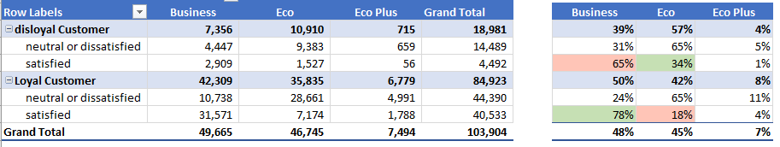
OTHER INSIGHTS
Half of the customers travelling in business class were observed to be loyal customers whereas this ratio is almost 10% lower in the economic class. This suggests, more benefits need to be provided to economic class passengers to try convert them into loyal customers.
Within the Economy class, only 18% of Loyal customers are satisfied, where 34% of regular passengers are satisfied. Therefore, can airlines provide better service/benefits to their regular passenger flying Economy class. On the contrary, Business class passengers that were loyal customer (78%) were more satisfied than regular customers (65%).
Online support appears to be a key determinant in influencing satisfaction. Customer service is a company’s opportunity to connect with customers, solve problems, and show they care.

Slide 19
FURTHER ANALYSIS
Thing to take into consideration:
Names of different airlines would be beneficial to have in analyzing airline passenger satisfaction
Location of airport boarding could also shed light on customer satisfaction. City location could have a bigger impact than the current columns.
Conduct a separate study on seat comfort. Seat comfort goes beyond the materials. Separate study to conduct how seat comfort impacts passenger satisfaction.
1.1% of the training dataset were customers below the age of 14 were observed to be travelling under “Business Travel”. This was an anomaly in the dataset.

